Slide 1
HPML Final Project · Spring 2026
Moss-TTS Integration for vLLM-Omni
Achieved DOUBLED tput and SIGNIFICANT improvement on FCL in the latest MOSS-TTS models
Omnipresent
Andrew Chung · ac5905
Yuting Liu · yl5961
Xingru Lu · xl3602
Yutao Mao · ym3019
GitHub: https://github.com/candylyt/vllm-omni
Tracking: https://wandb.ai/ac5905-columbia-university/hpml-final-project/runs/xfa9dt56?nw=nwuserac5905
Dr. Kaoutar El Maghraoui · Columbia University · Week of May 4, 2026
Notes:
Good afternoon everyone, we are team Omnipresent, and today we’ll be presenting our project on integrating MOSS-TTS models into vLLM-Omni.

Slide 2
Motivation & Problem
Time budget: 1 minute.
Why this matters
Problem statement
Vllm and Vllm-Omni have become an integral part of the LLM and Multimodal LLM inference serving system
Vllm-Omni is a relatively new iteration of Vllm, specifically integrating multimodal models that have different architectures from standard LLM
New Service → relatively few integrations of SOTA models
Moss-TTS is a SOTA family of TTS models that would be of use for many different organizations and people
Integrating Moss-TTS would allow for faster serving and inference, leading to a production level pipeline.
We attempt to integrate Moss-TTS-Local and Moss-TTS-Delay into the VLLM-Omni serving pipeline, specifically targeting inference bottlenecks
Goal: Match or exceed basic vanilla HF variants of both models, especially on the inference/throughput side.
HPML · Spring 2026
2 / 15
Notes:
Before diving into the technical details, I want to first explain why this project matters. Over the past few years, vLLM has become one of the most widely adopted inference serving systems for LLMs because of its efficiency and scalability. Building on top of that, vLLM-Omni extends the framework to include speech and audio generation. However, vLLM-Omni is still relatively new, and there are currently very few integrations of state-of-the-art text-to-speech models. Meanwhile, high-quality TTS systems are becoming increasingly important for applications like AI assistants and accessibility tools. In this project, we focus on integrating Moss-TTS-Local and Moss-TTS-Delay into the vLLM-Omni serving pipeline.
Our main motivation is not just to make the models run, but to specifically address inference bottlenecks and improve serving efficiency. The ultimate goal is to match or even exceed the throughput and latency performance of the original Hugging Face implementations.

Slide 3
Technical Approach — Model & Data
Time budget: ~1 min of the 3-min approach section.
Model
Dataset
Hardware
1. MOSS-TTS-Delay (Delay-Pattern Model)
Single large-scale Transformer backbone with a specialized "delay pattern"
8B parameters
2. MOSS-TTS-Local (Global-Latent + Local Transformer)
Global Transformer (Temporal) + Local Transformer (Depth)
1.7B parameters
1. Wikitext Dataset from hugging face (For metrics like RTF, FCL) (20 examples of varying lengths)
2. Static, fixed sentences for throughput benchmarks in order to reduce variance in our results.
A100 on Vast AI, a GPU rental website
VRAM: 80GB
Disk Size: 100GB
Google Colab A100 GPU
VRAM: 80GB
Disk: 235.7GB
HPML · Spring 2026
3 / 15
Notes:
Next, I’ll briefly introduce the models, datasets, and hardware setup we used for our experiments. We worked with two different TTS architectures.
The first is Moss-TTS-Delay, which uses a delay-pattern architecture built on a single large Transformer backbone with around 8 billion parameters. The second model is Moss-TTS-Local, which is smaller at around 1.7 billion parameters with a different architecture
For evaluation, we used two categories of data.
First, we used samples from the WikiText dataset with varying sentence lengths to evaluate metrics such as real-time factor and first-chunk latency.
Second, we used static fixed sentences for throughput benchmarking in order to reduce variance and ensure more consistent comparisons across different serving configurations.
Last but not least, for hardware, all experiments were conducted on NVIDIA A100 GPU with 80GB VRAM.

Slide 4

Technical Approach — Optimizations Applied
System-wide performance enhancements for efficient GPU utilization and reduced latency.
1. Stage-level Batching
2. Async Two-Stage Decoding
Amortizes GPU work across multiple requests by letting stages (especially decoder/audio) process batches together, cutting per-request overhead.
Splits TTS into streaming token-generation and waveform-decoding stages. Overlaps decoding with generation to significantly reduce TTFA.
3. KV-Cache Management
Reuses attention history in the local transformer. Processes only new tokens instead of recomputing growing context, speeding up MOSS-TTS-LOCAL.
HPML · Spring 2026
4 / 15

Slide 5
Technical Approach: MOSS-TTS-Delay Optimizations
Core system optimizations focusing on latency reduction and computational efficiency.
1. Incremental Async De-delay
2. Packed Embeddings & Heads
Scatters newly generated delay rows directly into restored codec-frame slots. Avoids rebuilding the matrix and re-applying de-delay every step.
Uses packed tensors for 32 modules/heads. Packed embedding [n_vq, vocab, hidden] is processed via batched projection/einsum for efficiency.
3. Vectorized Sampling
4. Dynamic Async Chunking
Tensorized sampling over request/codebook pairs. Skips redundant CPU history copies when repetition penalty is disabled (penalty=1.0).
Emits 3-frame initial chunk to minimize TTFA, then scales to 50-frame chunks to optimize decoder efficiency and scheduler overhead.
HPML · Spring 2026
5 / 15

Slide 6
Profiling Methodology
Tools used, what you measured, how you ensured measurements are stable.
Tools
Metrics captured
PyTorch Profiler / torch.profiler(HF)
vLLM Profiler(Integration of pytorch profiler)
vLLM logging
Weights & Biases for run-level tracking
RealTime Factor (Total Time/Audio)
First Chunk Latency(First chunk appears)
Throughput(Audio/Second)
Speedups (Relative to BS=1)
Average across three runs or ran multiple examples to ensure stability
HPML · Spring 2026
6 / 15

Slide 7
Results — Headline Numbers
25→70a/s
21.86s→0.56s
44%
Higher Throughput
Lower FCL in async-mode
less Kernel Launch time
HPML · Spring 2026
7 / 15
Notes:
These are some of the numbers that we thought were significant. We were able to significantly increase throughput, almost by 2.8 times the huggingface baseline for the best performing models. We also significantly reduced the FCL, or better put, integrated FCL, and we reduced Kernel Launch time by 44%!

Slide 8
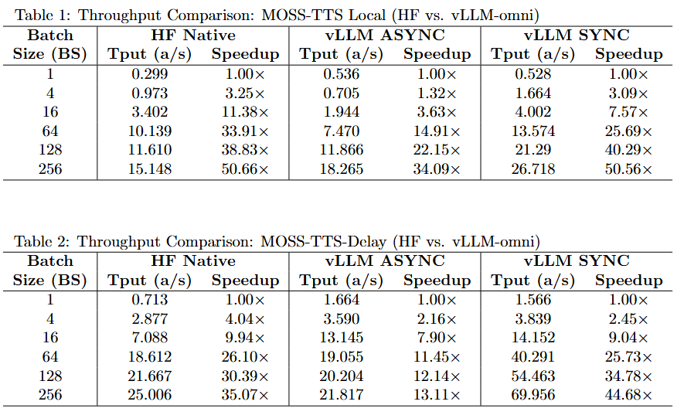
Results — Before vs. After - Throughput
Takeaway
Compared with the Hugging Face baseline, both vLLM-Omni variants improve throughput, and vLLM SYNC delivers the strongest end-to-end gains overall, reaching 26 a/s vs. HF’s 15.4 a/s at BS=256.
The biggest gain comes from vLLM-Omni’s stage-aware batching and scheduling. By processing multiple requests together, GPU work is amortized across a larger batch instead of repeatedly paying per-request overhead.
For the async delay model, it is to be noted that for batch size 128 and 256, it reaches an OOM error, defaulting to single requests after memory is exceeded.
HPML · Spring 2026
8 / 15
Notes:
This table represents a before and after for our throughput comparisons of the HuggingFace and VLLM variants. We can see that as batch size continues to increase, the vllm variants tend to completely outperform the HF variants in throughput, or audio per second. One of the most significant finds is how vLLM Sync for the Delay model generates a whopping 69 seconds of audio per second, crushing the HuggingFace and Async Variants by almost 2.7 times the amount of audio generated by the second. We also point out that for the delay model, with the 128 and 256 batch sizes, we actually run out of memory making the model default to single request backup process, which hinders the speedup and overall throughput. With more GPUs, for example separating the stage 0 and 1 process into two separate GPUs, we may have even greater gains.

Slide 9
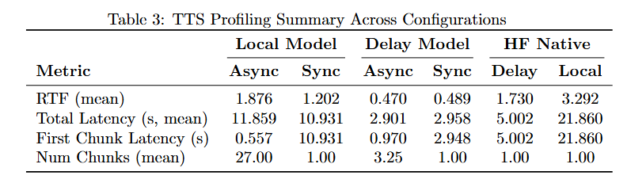
Results — Before vs. After - FCL
Takeaway
First Chunk Latency(TTFA) is significantly reduced for Async methods, which are optimized for outputting while generating
RTF for all variants of the VLLM-Omni models are significantly lower than the HF counterparts
HPML · Spring 2026
9 / 15
Notes:
Continuing, we also take a look at more serving side metrics. This is where Async variants of the model truly shine. Async is built to stream audio while generating the output, meaning that the FCL or Time to first Audio is significantly reduced compared to synchronous and HF model variants. You will notice that synchronous and HF models have the same total latency and first chunk averages, signifying that audio is not streamed until everything is generated completely. Overall, we can see the real time factor of both local and delay VLLM variants significantly outperform HF variants, showcasing the VLLM optimizations.

Slide 10
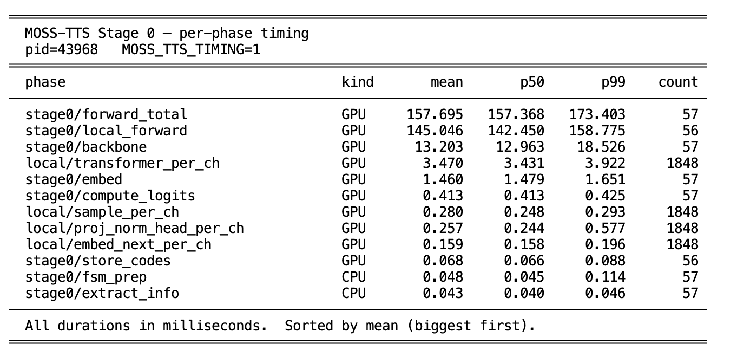
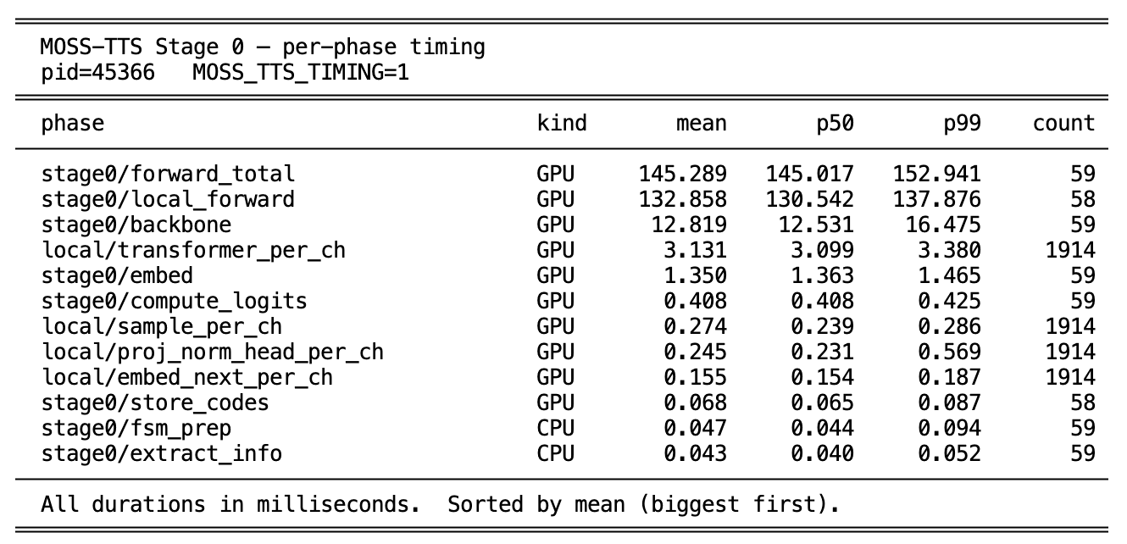
Profiler Evidence - Stage 0 Local Transformer
MOSS-TTS-LOCAL
Before KV-Cache
After KV-Cache
~8%
CUDA Time Reduction
HPML · Spring 2026
10/ 15
Notes:
Here we show our profiling, where the top portion showcases the vllm profiling, and we point out a significant bottleneck, the stage0/local_forward. We compare the results of before and after the KV Cache, showcasing an 8 percent CUDA time reduction.

Slide 11
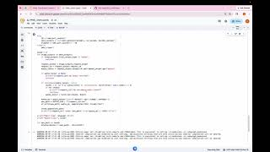
Demo / Visualization
HPML · Spring 2026
11 / 15

Slide 12
Lessons Learned
Time budget: 1 minute. What surprised you? What didn't work? Be honest.
What worked
What didn't work
Successful end-to-end Integration with vLLM-omni for both MOSS-TTS-Local and MOSS-TTS-Delay
PagedAttention & Fused Kernel supported natively by vLLM’s version of Qwen3 were the main contributors to the improved performance in throughput.
Async_chunk mode supports stage-level pipeline concurrency, decreasing TTFA significantly.
Increasing the decoder/audio stage batch size improves throughput, especially under concurrent requests.
Stage 0 Local Transformer for MOSS-TTS-Local should have been fully integrated into a vLLM-compatible implementation in order to leverage optimizations such as PagedAttention and fused kernels, rather than relying on the original Hugging Face variant
CUDA Graph for multiple batch_sizes (incompatibility between torch.compile and OmniOutput).
Due to architectural differences between the original Hugging Face implementations and our integrated models, as well as the differing profiling scopes provided by vLLM, PyTorch profiling yielded only limited insights into the actual optimization performance.
HPML · Spring 2026
12 / 15

Slide 13
Next Steps
Test more prompting styles: Moss-TTS can accept things like reference audio, ambience noise, and may also be interesting to give it specific instructions rather than just straight Text to Speech Tasks with no variance
Test on Multi-GPU setups: Currently test on just 1 GPU for both stages of the architecture due to cost. More memory would allow for potentially faster inference and larger throughput.
More on Optimization: Currently, we got some preliminary results for CUDA Graph mode on delay model. It’s mainly applied to the AR backbone, which requires repeated kernel launches when predicting audio codes. With CUDA Graph open, Self CPU time is decreased by 44%.
More real time benchmarking: Everything that was benched in this dataset was relatively controlled; it may be more interesting to test out harder/more complex text examples and mimic a real time serving environment with random requests and on the fly processing of requests.
HPML · Spring 2026
13 / 15

Slide 14
Teamwork & Contributions
Time budget: 30 seconds. Who did what. Required slide — graded individually.
Member | Primary contributions | Tools / artifacts
Andrew Chung | Developed metric scripts, wandB integration | metric-branch
Yuting Liu | Integration of the MOSS-TTS-Local Model Optimization: KV-Cache for Local Transformer in Stage 0 & Batch Decoding for Stage 1 | moss-tts-local branch moss-tts-local-optimization branch
Xingru Lu | Integration of the MOSS-TTS-Delay Model (async_chunk mode), part of profiling work Optimization: CUDA Graph | moss-tts-delay branch metric-branch
Yutao Mao | Implementation of the MOSS-TTS-Delay Model integration and Stage 1 decoder optimization | moss-tts-delay branch
Tend to work individually, convene for biweekly meetings with our mentor, Roger(VLLM Maintainer), and communicate over messaging
HPML · Spring 2026
14 / 15

Slide 15
Thank you
Questions?
GitHub: https://github.com/candylyt/vllm-omni
Tracking: https://wandb.ai/ac5905-columbia-university/hpml-final-project/runs/xfa9dt56?nw=nwuserac5905
HPML · Spring 2026
15 / 15

Slide 16
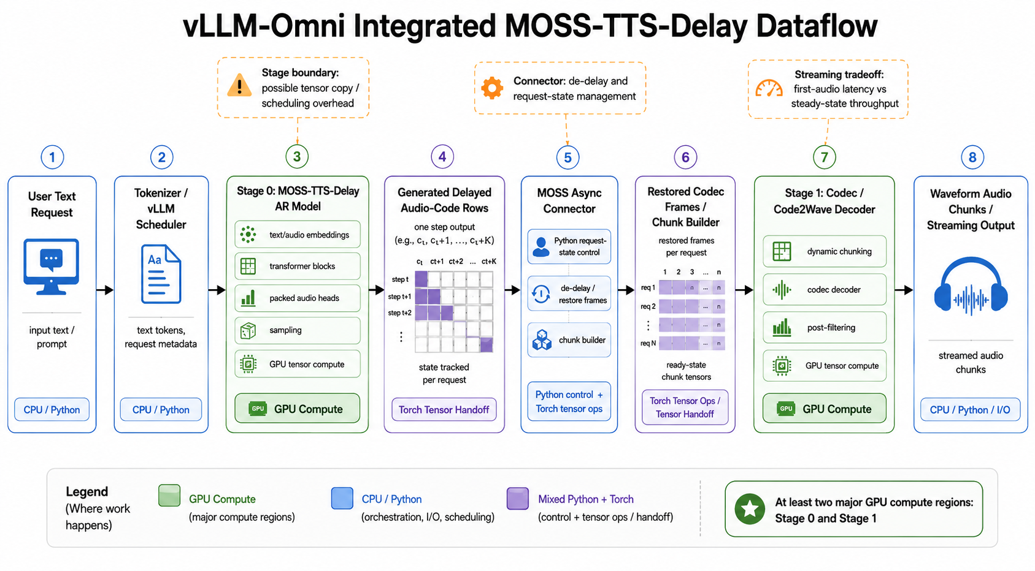
Appendix — Delay Model Integration

Slide 17
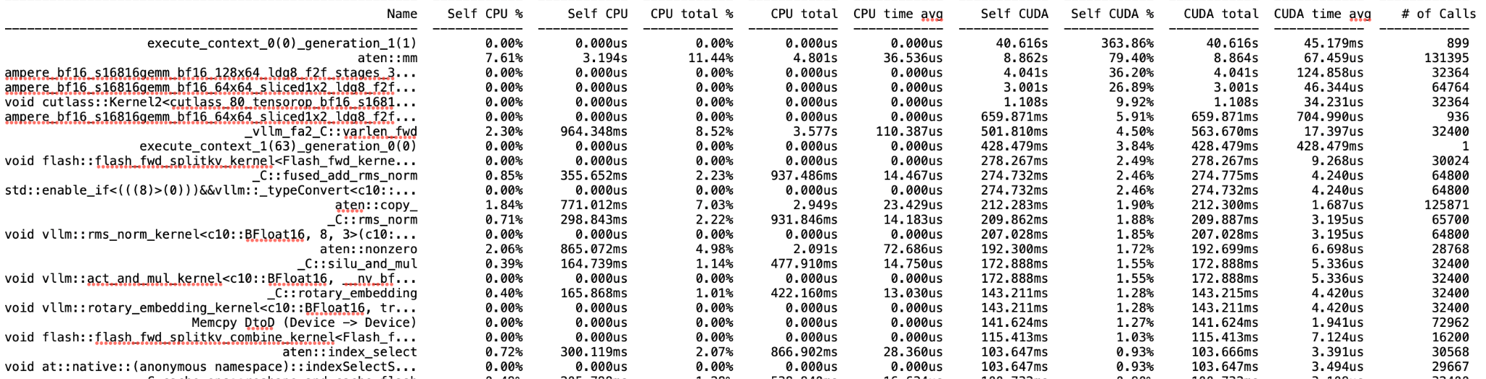

Backup — Preliminary Results of CUDA Graph

Slide 18
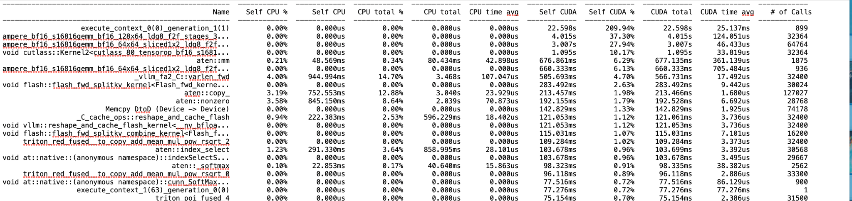

Backup — Preliminary Results of CUDA Graph

Slide 19
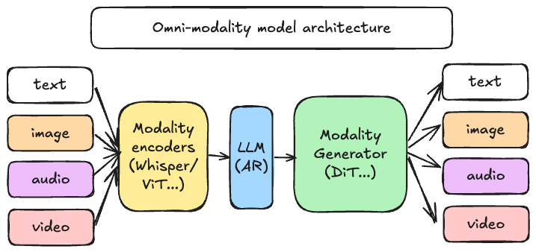
Appendix — vLLM-Omni Introduction
Motivation
— Any-to-any models combine multiple heterogeneous components.
— Existing LLM serving systems mainly optimize single AR decoding.
— Manual multi-stage orchestration causes poor batching, poor resource usage, and high latency.
Reference: vLLM-Omni Official Slides

Slide 20
Appendix — vLLM-Omni Introduction
AR
vLLM-Omni
Diffusion
Main component
Entrypoints: offline/online serving, OmniStage abstraction for model stages(AR/DiT)
AR module: inherited from vLLM(CB/PA/Prefix Cache…) and adapted to the Omni-modality model
Diffusion module: implemented natively and optimized by acceleration components
Model/Layer/ops: parallelism, quantization, attention…
OmniConnector: natively supports E/P/D/G disaggregation
EntryPoints
APIServer
Omni/AsyncOmni
OmniStage
LLMEngine
DiffusionEngine
Scheduler
Cache Engine
Scheduler
Executor
Worker
Worker
ModelRunner
ModelRunner
/Pipeline
Model/Layer/Ops
OmniConnector（E/P/D/G）
imported
modified
new
Reference: vLLM-Omni Official Slides

